Slide 1



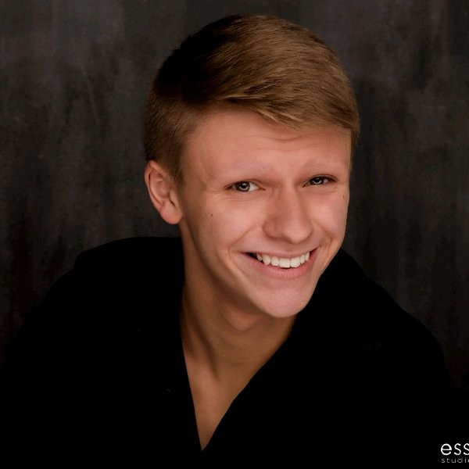
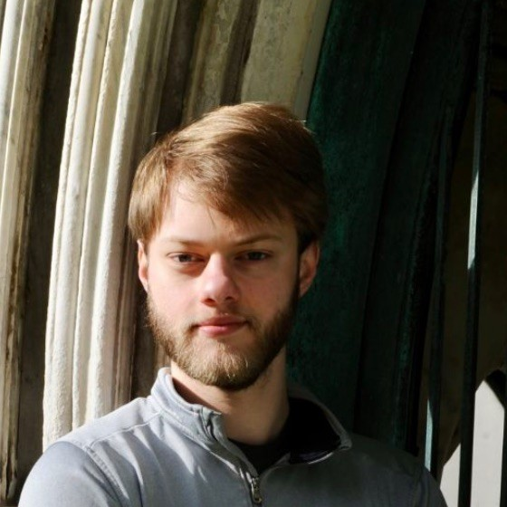

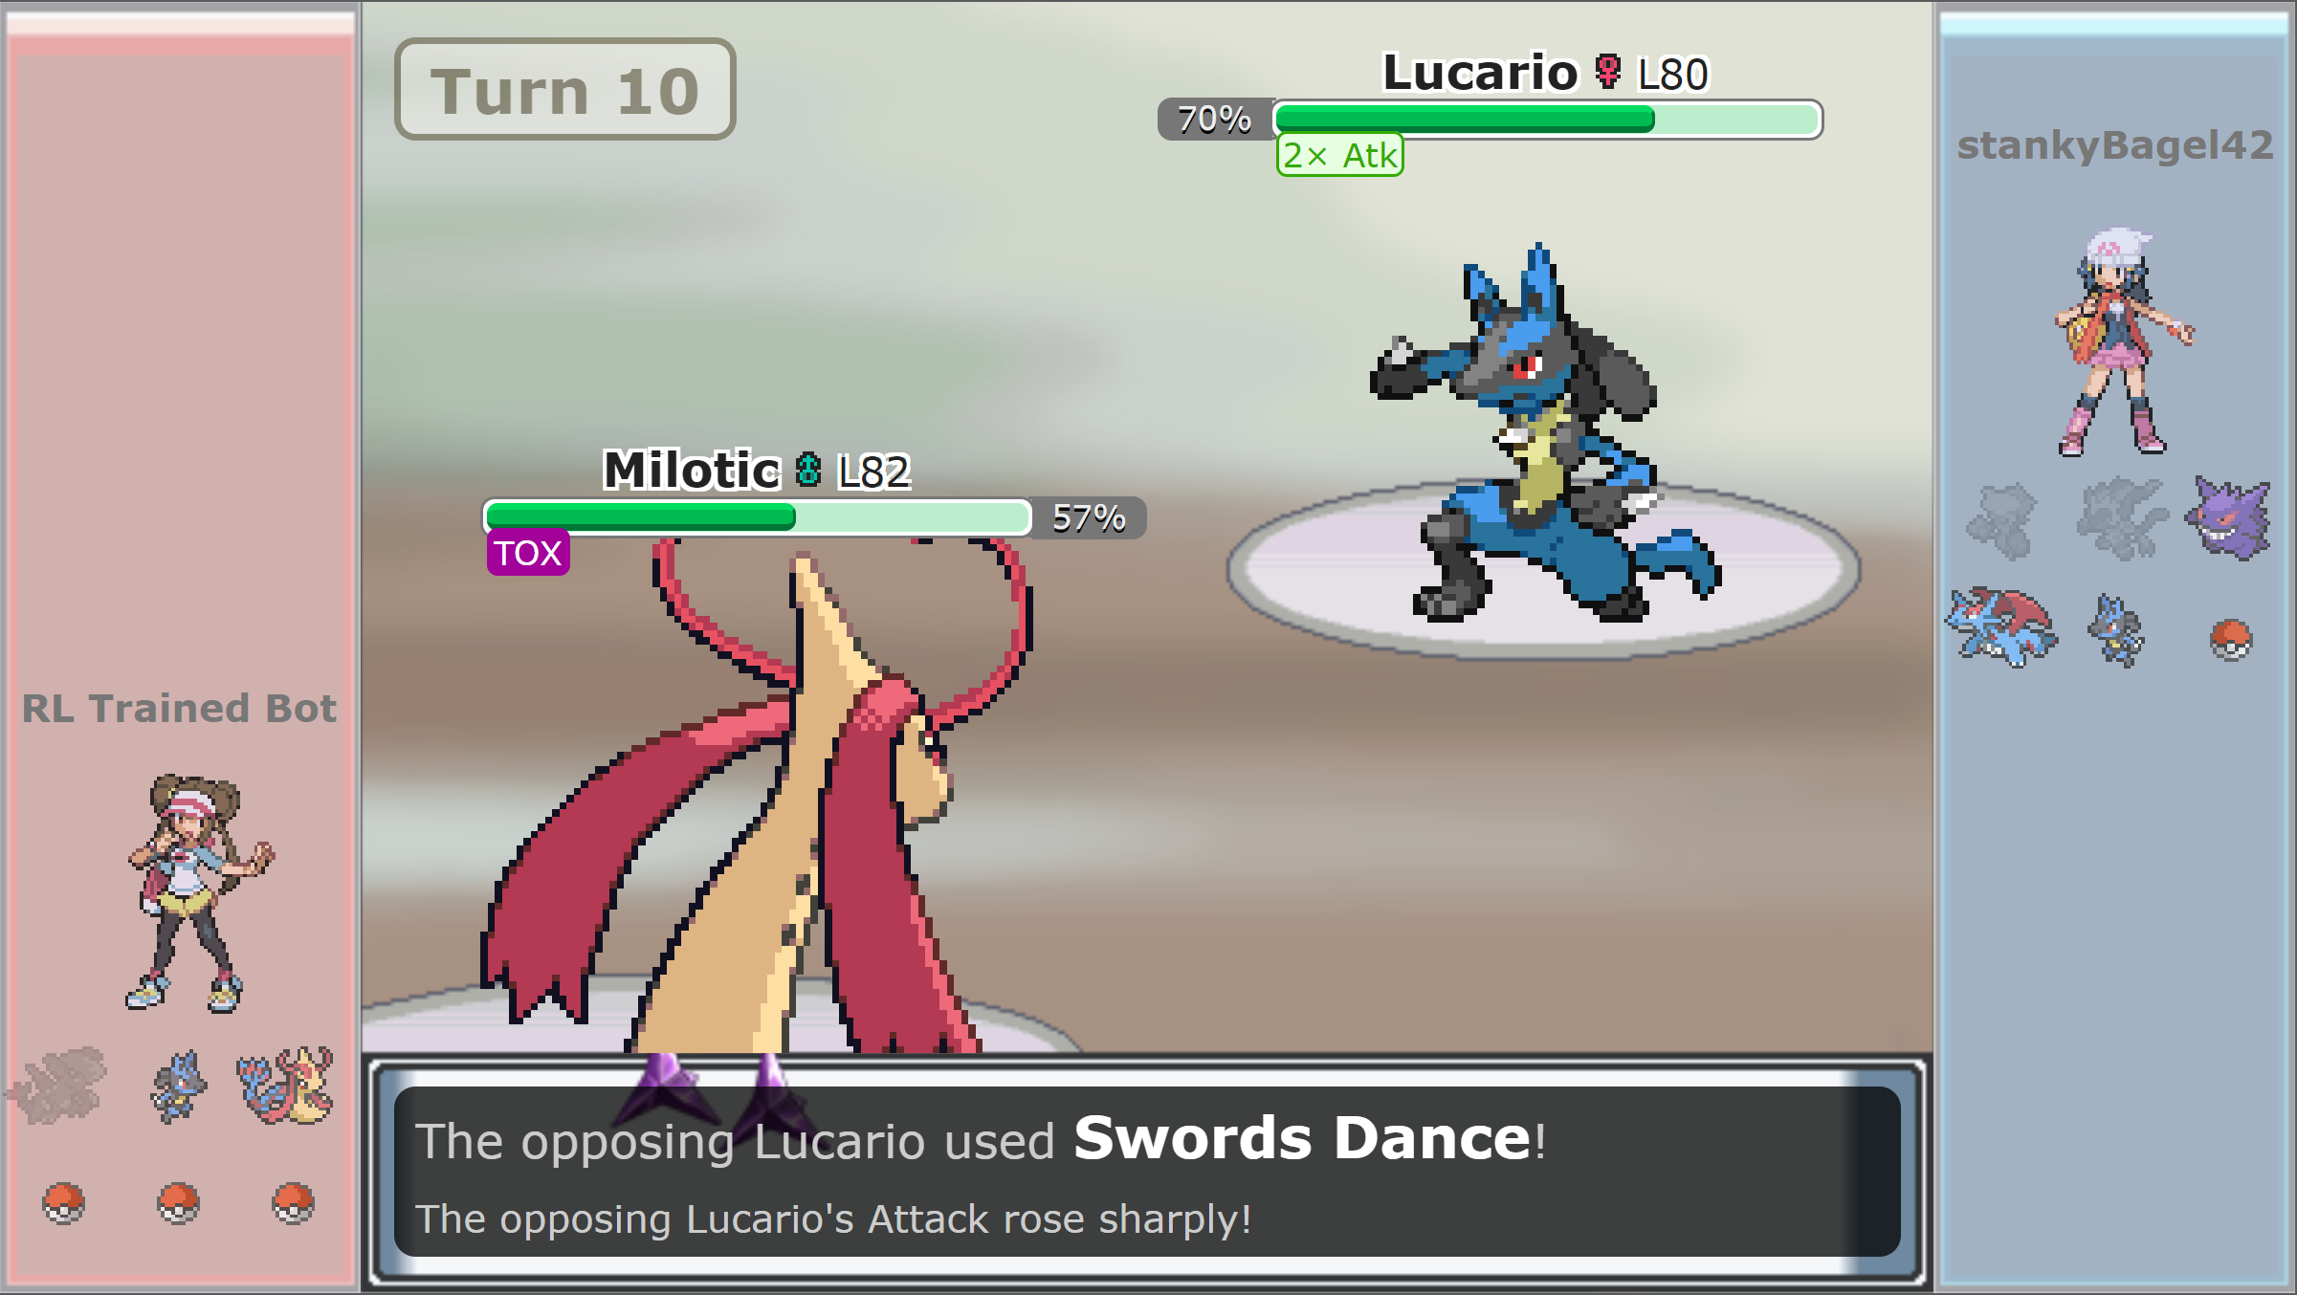



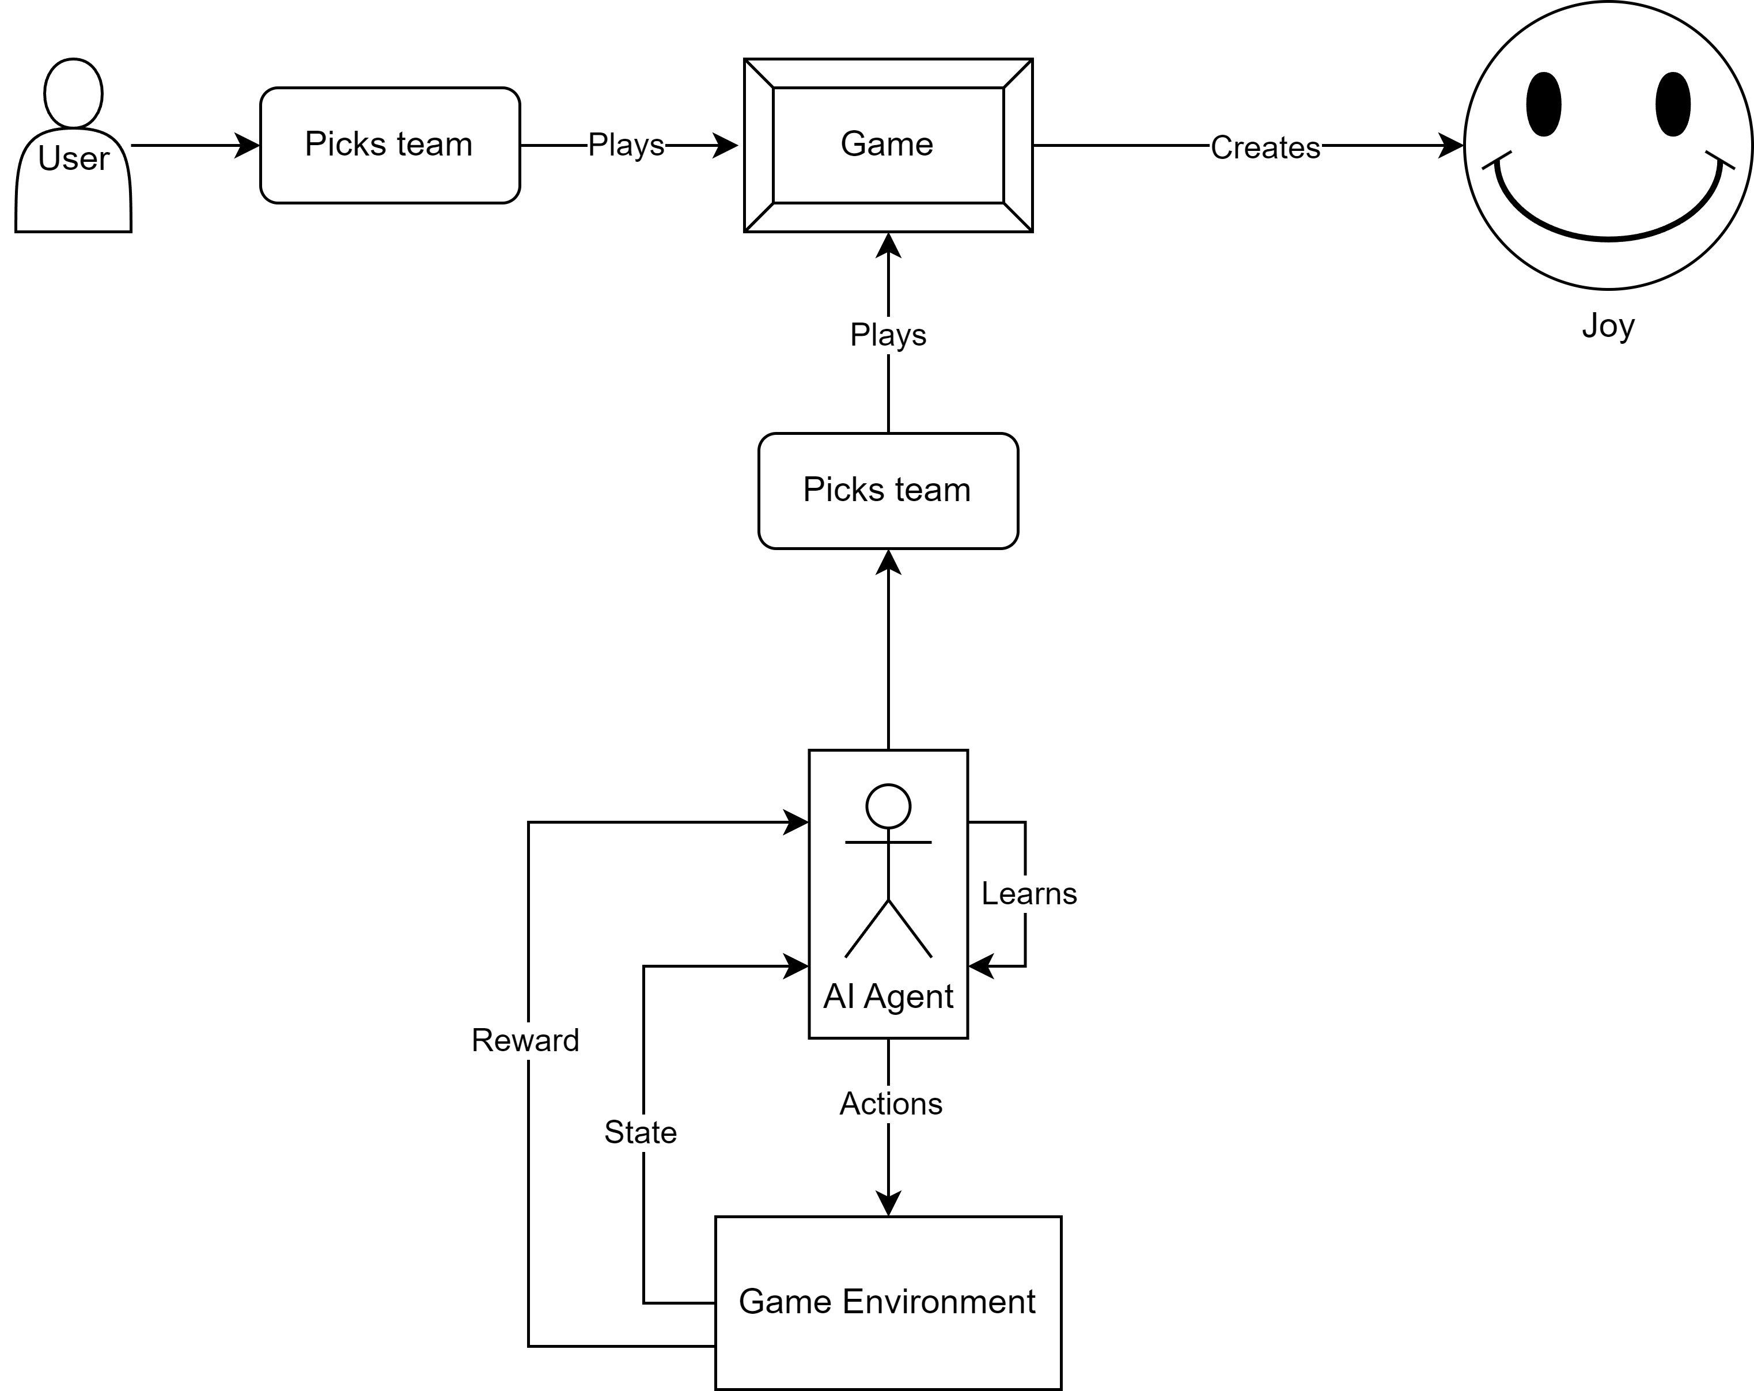

AI Pokémon Battler
Alex Turner
Design Lead
Eric Wolff
AI Development Lead
Nick Sucietto
Server Operations Lead
Dr. John Gallagher
Advisor
ABSTRACT
RL METHODOLOGY
GAMEPLAY
Our senior design project aims to develop an AI agent capable of playing as a Pokémon trainer using the popular online battle simulator, Pokémon Showdown’s public API. This project leverages the power of reinforcement learning techniques to create a proficient virtual trainer capable of making strategic decisions in a dynamic and competitive environment.
The player agent was trained using a Double Deep-Q Network to prevent overestimation bias in Q-Learning by decoupling the action selection and evaluation processes.
During gameplay, the agent perceives the game state with information about the Pokémon on each team, as well as Field Effects, including player-specific effects such as Poison and Full Field Effects such as Sandstorm.
For the purposes of this project, all gameplay uses Generation IV Pokémon in an “Anything Goes” format.
Not pictured here are the game log on the right side of the user’s screen and the move buttons that would appear below.
DESIGN DIAGRAM
CHALLENGES
RESULTS
NEXT STEPS
The biggest challenge was getting the agent to communicate properly with the Pokémon Showdown environment. There were also many edge cases in Pokémon battles that needed to be accounted for in creation and training of the agent.
Currently, the agent is able to beat a heuristic function bot that we use for benchmarking performance and is capable of beating human opponents.
It is our estimation that the agent is a good match for novice to intermediate opponents.
In the future, we hope to expand the Battler’s capabilities to fight in multiple Pokémon Generations and in Doubles Battles.

